Slide 1
SystemVerilog classes, randomization, functional coverage.
Ranjith

Slide 2
Objectives
Overview of system Verilog Classes
Defining and Constructing classes
Dynamic nature of classes
Static properties and methods
LSI Confidential

Slide 3
Object Oriented Programming.
Traditional programming deals with data and functionality separately
  Must declare discrete signals for all parts of design
  These routines often have many side effects, so that calling one routine causes that you did not intend
  This is tightly coupled to one implementation, and hard to reuse.
OOP organizes information in a better way
  Encapsulation -- closely ties data and functionality
  Inheritance -- extends the functionality of existing objects
  Polymorphism -- wait until run time to bind objects
  An object defined and well debugged can be reused by using it to create a new, more complex object by adding new data and routines.
LSI Confidential

Slide 4
OOP Terminology
Class
  A block containing related group of features and functionality.
  Encapsulates functionality
Object
  Instance of a class
Handle
  Pointer to an Object.
Properties
  Variable that holds data
Methods
  Tasks and functions specific to class
LSI Confidential

Slide 5
Class Definition Example
class Transaction;
//properties
rand bit [31:0] src,des,data[8];
bit [31:0]crc;
//Constructor method
function new;
des=1;
endfunction
virtual function void print(input string prefix="");
$display("%sTr :: src =%h des =%h crc=%h\n",prefix,src,des,crc);
endfunction
virtual function void calc_crc;
crc = src ^ des ^ data.xor;
endfunction
endclass
LSI Confidential

Slide 6
Class Instances
To use a class, there are two steps.
  Declare a variable of the class type
    This only creates the object handle variable;
    the object does not yet exist
  Use the new method to construct an object
    Allocates memory for the object
    The two steps can be combines
    Transaction Tr;
    Tr = new;
Transaction Tr=new;
LSI Confidential

Slide 7
Accessing Properties and Methods
An object’s properties and methods are accessed using the instance name and dot-operator(.)
class transaction;
rand bit [31:0] src,des,data[8];
bit [31:0]crc;
virtual function void calc_crc;
crc = src ^ des ^ data.xor;
endfunction
endclass
Transaction Tr=new;
initial
begin
Tr.des = 20;
Tr.calc_crc;
end
endmodule
LSI Confidential

Slide 8
New Function Class Constructor
The new function is called class constructor
  Every class has a implicit new method
    Properties are set to the uninitialized value of data type.
Optionally a custom new constructor can be defined.
  Allows initializing properties to specific values.
  Only one custom new method can be created per class.
class Animal;
int age;
logic [7:0]weight;
endclass
Animal a;
initial begin
a= new;
$display(“ age = %d weight=%d”,a.age,a.weight);
end
Prints: age=0 weight=xx
class Animal;
int age;
logic [7:0]weight;
function new;
age = 1;
weight = 10;
endfunction
endclass
Animal a;
initial begin
a= new;
$display(“ age = %d weight=%d”,a.age,a.weight);
end
Prints: age=1 weight=10
LSI Confidential

Slide 9
Configurable Class constructors
A user-defined new function can have arguments
  Allows for specialized initialization of variables
  Allows for default values on arguments
The keyword this refers to properties or methods in the current instance of an object
  this is a handle to the object containing this
  Allows a method to reference properties that are in the class
class Animal;
int age;
Int weight;
function new(int age, int weight=1);
this.age = age;
this.weight = weight;
endfunction
endclass
LSI Confidential

Slide 10
More on class variables
A class variable holds a handle to an object.
Multiple class variables can refer to the same object
  If a second Animal variable is declared and assigned a1, there will still only be one instance of the object, but with two handles
Animal a1;//creates variable a1, initial value is null
a1= new;
a1
Animal object1
Animal a2=new;
a2=a1;
a2
Animal object1
a1
LSI Confidential

Slide 11
Copying Class Objects
A new object can be created that is a copy of an existing object using <second_hadle> = new <first_handle>
Referred to as a “copy constructor”
A class property can be a handle for another object
Animal a2=new a1;
Animal object1
a1
a2
Animal object2
class Mobility;
int legs;
endclass
Animal a1=new;
age
class Animal;
int age;
int weight;
Mobility m_handle;
function new;
m_handle = new;
endfunction
endclass
weight
m_handle
Mobility Object
LSI Confidential

Slide 12
Shallow Copies of objects
The in-line copy constructor performs a shallow copy
  Only copies the value of properties and handles
A custom copy method must be written to do a deep copy
Animal a1;
Animal a2=new a1;
a1
a2
age
age
weight
weight
m_handle
Mobility Object
m_handle
LSI Confidential

Slide 13
Static and Automatic Storage
By default storage in each instance of modules, interfaces and programs is static
  The storage is allocated before the simulation starts running, and exists throughout simulation
  This includes all storage within tasks and functions
Classes are different
  By default, all storage in classes is automatic
    The storage is created when an object is constructed
    Unique storage is created for each instance of the object
    The storage disappears when the object goes away
    This includes all storage within class methods (tasks and functions)
SystemVerilog garbage collection happens automatically
LSI Confidential

Slide 14
Static Properties & Methods
Properties can be declared as static properties
  Memory allocated only once for all instances of the class
  The value property is shared between all instances of the class
Methods can also be declared as static
  Can only access other static methods and properties
  Can be accessed outside the class object using just the name of the class
class score_board;
static int num_of_errors;
static function void print_error();
$display(“ Total num of errors=%d”,num_of_errors”);
endfunction
endclass
score_board :: print_error;
LSI Confidential

Slide 15
External Methods
Class methods can be defined outside of the class body
  The class contains an extern definition (a prototype) of the method
  The method is defined outside of the class
class transaction;
rand bit [31:0] src,des,data[8];
bit [31:0]crc;
extern function calc_crc();
endclass
function void transaction:: calc_crc();
crc = src ^ des ^ data.xor;
endfunction
LSI Confidential

Slide 16
Data Hiding and Encapsulation
By default the properties in a class are public
  Can be accessed from outside the class using an object handle
Properties can be hidden by declaring them as local or protected.
  Can be accessed by methods inside the class.
class Transaction;
local bit [31:0] src;
protected bit [31:0] des,crc,data[8];
function
endclass
LSI Confidential
Notes:
Encapsulation is an application of the structuring principle. The idea behind encapsulation is to hide implementation details and decouple the usage of a function from its implementation. That way, the implementation can be modified or optimized without affecting the users, as long as the interface is not modified.

Slide 17
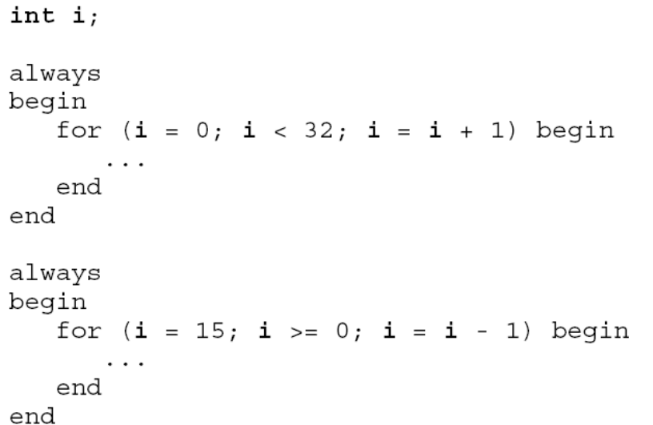
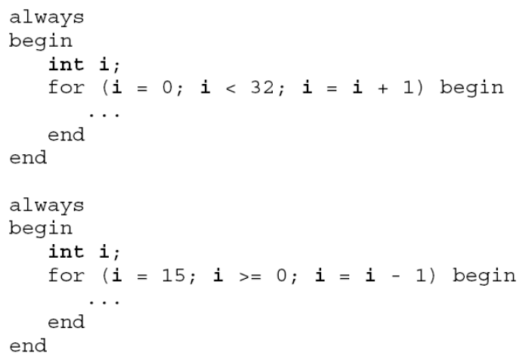
Encapsulation
LSI Confidential

Slide 18
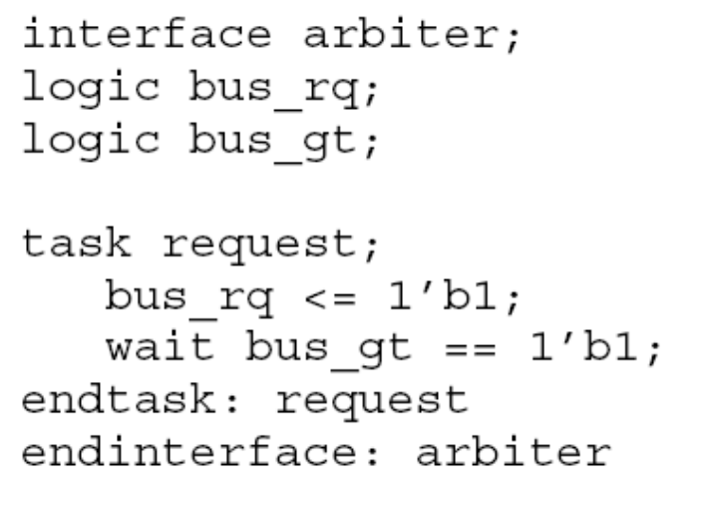
Encapsulation
Bus-functional model tasks can be encapsulated in an interface.
LSI Confidential

Slide 19
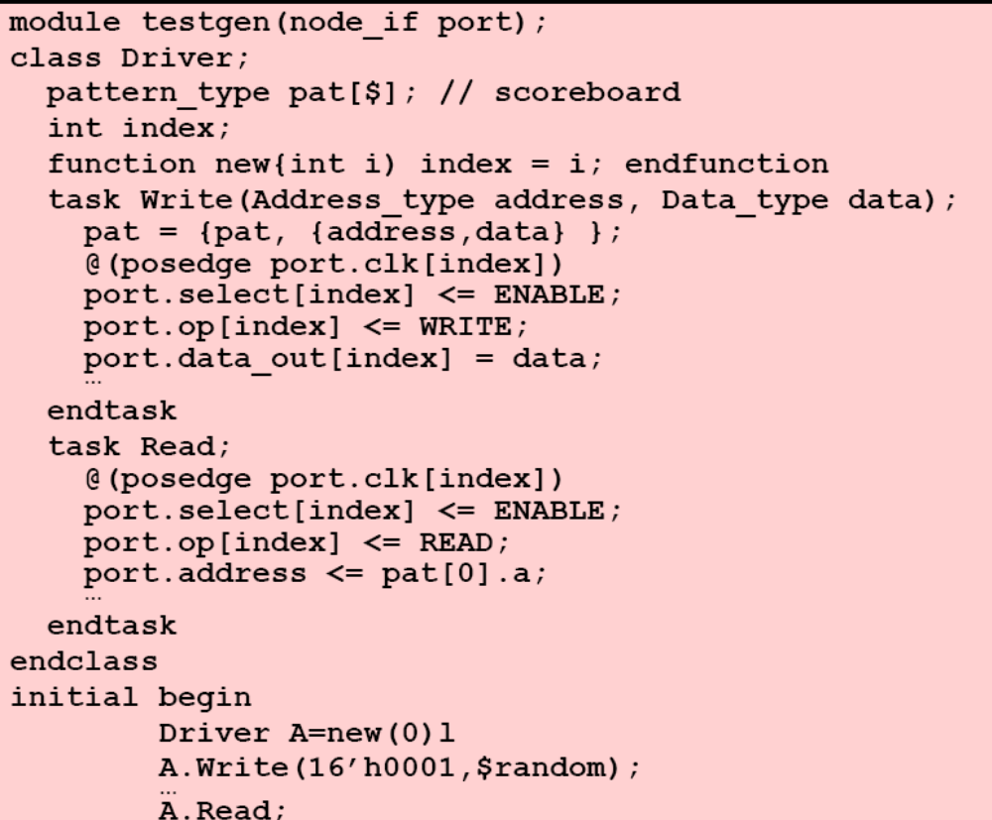
Encapsulation
LSI Confidential

Slide 20
Class Objects cannot drive Module Ports
Class methods cannot directly drive the ports of a design
  Modules are static – they exist from the beginning to the end of simulation
  Classes are dynamic – they can be constructed and destructed any time during simulation
module test_add;
logic [3:0]sum;
logic carry;
logic [3:0]a,b;
class add_c;
rand bit [3:0] a;
rand bit [3:0] b;
function send_data(output [3:0]a,b);
.a = this.a;
.b = this.b;
endfunction
endclass
add add(.a(add_if.a),
.b(add_if.b),
.sum(sum),
.carry(carry)
);
…
endmodule
LSI Confidential

Slide 21
Connecting to the design using virtual interfaces
Classes can only drive ports through a “virtual interface” handle
  A special variable that can hold a handle to an interface port
  Allows dynamic class objects to indirectly drive static methods
interface add_interface;
logic [3:0] a;
logic [3:0] b;
endinterface
module test_add;
add_interface add_if();
logic [3:0]sum;
logic carry;
class add_c;
virtual add_interface add_if;
rand bit [3:0] a;
rand bit [3:0] b;
function new( virtual add_interface add_if);
this.add_if = add_if;
endfunction
function post_randomize();
add_if.a = a;
add_if.b = b;
endfunction
endclass
add_c add_c0 = new(add_if);
initial begin
for(int i =0; i<10;i++) begin
if(add_c0.randomize() ==1 )
begin
#10
$display(" a= %d , b=%d sum=%d carry=%d",add_if.a,add_if.b,sum,carry);
end
end
end
add add(.a(add_if.a),
.b(add_if.b),
.sum(sum),
.carry(carry)
);
endmodule
LSI Confidential

Slide 22
Extending a class definition
A new class can be defined as an extension of an existing class using the extends keyword
  The new “derived class” inherits the properties and methods from the “base class”, and can add additional properties and methods
class transaction;
bit [31:0] src,des,data[8];
bit [31:0]crc;
virtual function void calc_crc;
crc = src ^ des ^ data.xor;
endfunction
endclass
class badTr extends transaction;
bit bad_crc;
function void print(input string prefix="");
$display("%sTr :: bad_crc=%h",prefix,bad_crc);
endfunction
function void calc_crc;
super.calc_crc;
if(bad_crc) crc= ~crc;
endfunction
endclass
transaction Tr=new;
badTr bad_Tr = new;
bad_Tr.calc_crc;
LSI Confidential

Slide 23
Data Hiding and Inheritance
Properties and methods in a class can be :
  Public (the default)
    Can be accessed from outside the class
    Is inherited by a child class
  Protected
    Cannot be accessed directly from outside the class
    Is inherited by a child class
  Local
    Cannot be accessed directly from outside the class
    Is not inherited by a child class
class transaction;
local bit [31:0] src
protected bit [31:0]des,data[8];
protected bit [31:0]crc;
virtual function void calc_crc;
crc = src ^ des ^ data.xor;
endfunction
endclass
class badTr extends transaction;
bit bad_crc;
function new();
src = 1; //error
des = 2;
for(int i=0;i<8;i++)
data[i] = 0;
endfunction;
endclass
badTr bad_Tr = new;
initial
begin
bad_Tr.bad_crc = 1;
bad_tr.des = 2; //error
end
LSI Confidential

Slide 24
Referring to the current instance and the Parent class
This is a handle to the current instance of an object
Super is a handle to the base class of a derived object
A derived class can only look up to its parent base class
class Animal;
int age=1;
task incage();
this.age++;
endtask
function int getage();
return this.age();
endfunction
endclass
class Dog extends Animal;
int dog_yrs_factor = 6;
function int getage();
return super.getage* dog_yrs_factor;
endfunction
endclass
LSI Confidential

Slide 25
Virtual Methods
Parent methods can be declared as virtual
  When a child object handle is assigned to the parent handle type, the parent will use the child’s properties and methods.
class Animal;
int age=1;
task speak();
$display(“Grunt”);
endtask
endclass
class Dog extends Animal;
task speak();
$display(“Bow Bow”);
endtask
endclass
Dog d = new;
Animal a=d;
a.speak();
class Animal;
int age=1;
virtual task speak();
$display(“Grunt”);
endtask
endclass
class Dog extends Animal;
task speak();
$display(“Bow Bow”);
endtask
endclass
Dog d = new;
Animal a=d;
a.speak();
LSI Confidential

Slide 26
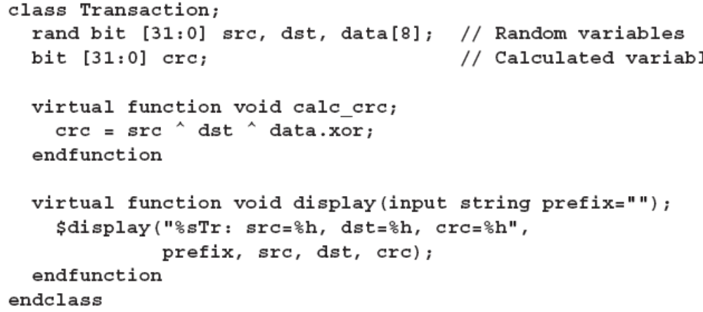
Virtual Properties and Methods
Parent properties ad methods can be declared as virtual
  When a child object handle is assigned to the parent handle type, the parent will use the child’s properties and methods.
LSI Confidential

Slide 27
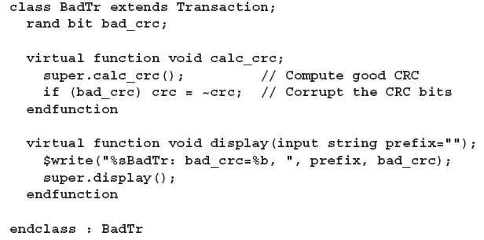
Virtual Methods
LSI Confidential

Slide 28
Pure Virtual Methods
A base class can define “pure virtual methods”
  A pure virtual method is a prototype fot the actual method
    Every derived class must complete all pure base class methods
    Every completed method must match the prototype
class Animal;
local int age;
pure virtual task speak(bit [1:0]mood);
function int getage();
return this.age();
endfunction
endclass
LSI Confidential

Slide 29
Virtual Base classes
A class can be defined “virtual”
  Objects cannot be constructed from virtual class
A handle of a virtual class can be declared
  The virtual class handle can be assigned the handle of a subclass
LSI Confidential

Slide 30
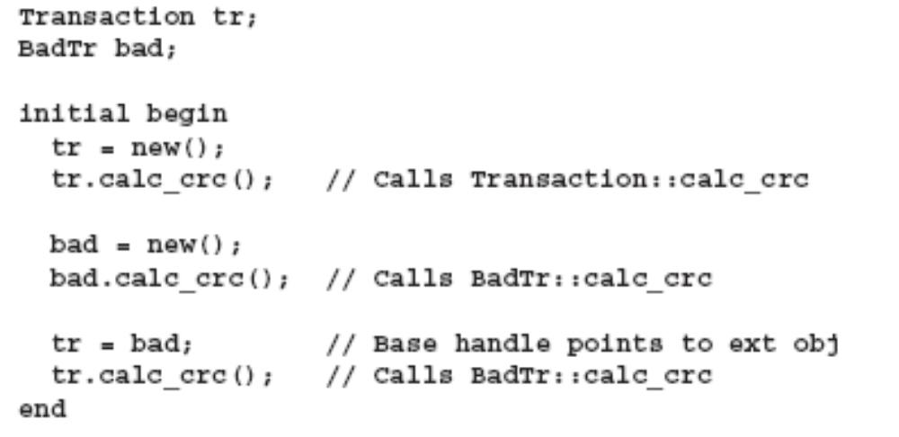
Polymorphism
Polymorphism allows single handle type to reference many different types of objects.
LSI Confidential

Slide 31
Constant Properties
Class properties can be made read-only using const
LSI Confidential

Slide 32
Unconstrained Random Variables
Verilog has a $random system function
  Returns a 32-bit signed random value using uniform distribution
  Cannot be constrained
  Can be seeded, but affects all calls to $random throughout simulation
function opcode_t get_opcode();
case ({$random}%4)
0 : opcode = AND;
1 : opcode = SUBTRACT;
2 : opcode = MULTIPLY;
3 : opcode = DIVIDE;
endcase
return opcode;
endfunction
Since $random cannot be constrained, the return value must be manipulated to limit the value
The concatenate operator converts the signed value to unsigned
The modulus operator returns the remainder of integer division
LSI Confidential

Slide 33
Randomized Case Statements
A randcase statement randomly selects one of its branches
  The randcase item expressions are the probability weights.
    The probability of taking a branch is the weight of that branch divided by the sum of all weights.
    The weights can be based on variables, as well as constants.
randcase
4 : opcode = ADD; //40% probability (4/10)
2 : opcode = SUBTRACT; // 20% probability (2/10)
3 : opcode = MULTIPLY; // 30% probability (3/10)
1 : opcode = DIVIDE ; // 10% probability(1/10)
endcase
LSI Confidential

Slide 34
Uniform Distribution Random Variables -rand
Class properties(variables) can be declared to allow randomization using rand
rand specifies that randomization will produce random values that are uniformly distributed over the range of the variable.
  Each time the variable is randomized, each value in its range has an equal probability of occurring.
  The probability of the same value being repeated on successive calls to the randomizer is 1/<range_of_variable>.
Only 2-state random values are generated
  Randomization never produces X or Z values.
class Bus;
rand logic [15:0] addr;
rand logic [7:0] data;
endclass
LSI Confidential

Slide 35
Cyclic Distribution Random Variables - randc
randc specifies that randomization will produce random values that are cyclic over the range of the variable
  Randomly iterates over all the values in the range
  No value is repeated within an iteration.
  When the iteration finishes, a new iteration automatically starts.
  Randc variables can only be of type bit or enumerated types
  Tools can limit randc to a maximum size, but the maximum can be no less the 8 bits (to reduce memory requirements)
  Randc variables must be solved before other random variables.
randc bit[2:0]y;
LSI Confidential

Slide 36
The ,randomize() Randomization Methos
Variables in an object are randomized using the randomize() class method.
  Every class has a built-in randomize() virtual method.
  Randomize() generates random values for all active random variables in the object – subject to active constraints.
  Randomize() returns 1 if it successfully sets all the random variables and objects to valid values, otherwise it returns a 0
class A;
rand int a ;
constraint c_a {a <10;}
endclass
A a_c = new;
Initial
if(a_c.randomize())
$display(" class %d %d",a_c.a);
LSI Confidential

Slide 37
Controlling Which Properties are Randomized
The randomize() method can be called with arguments.
  The arguments specify which properties are to be randomized
    Only the properties listed are randomized.
    The properties do not need to be specified with rand or randc
class A;
rand int a ;
rand bit[3:0]b;
int c;
constraint c_a {a <10;}
endclass
A a_c = new;
Initial
if(a_c.randomize())
$display(" class %d %d",a_c.a,a_c.b,a_c.c);
if(a_c.randomize(b,c))
$display(" class %d %d",a_c.a,a_c.b,a_c.c);
LSI Confidential

Slide 38
Disabling Randomization
Rand_mode() can be used to:
  Enable or disable the randomization of all class properties
  Enable or disable the randomization of specific class properties.
Object_name.rand_mode(0);
Object_name.property_name.rand_mode(0);
Status = Object_name.property_name.rand_mode(0);
LSI Confidential

Slide 39
Constraint Blocks
Random values are limited to a specific set of values using constraint expressions
  Constraint expressions are defined in constraint blocks, using { }
constraint c_NRZ12B {NRZ12B == 1;}
LSI Confidential

Slide 40
Constraint Properties
Constraints can be any Sytem Verilog expression with “integral” variables, constants or literal values.
  bit, reg, logic, int, enum, packed struct, etc are allowed.
  Time, real, unpacked struct etc are not allowed
If a solution exists, the constraint solver must find it
  The solver can fail if over constrained, and there is no combination of random values that satisfy the constraints
    Randomize() will return 0 if a random value is not found
LSI Confidential

Slide 41
Disabling Constraints
Some times constraints need to be deliberately disabled to allow testing of error checkers and other similar logic.
  Constraint_mode(0) disables a named constraint block
  Constraint_mode(1) enables a named constraint block.
rwi_cfg.c_SECTORS.constraint_mode(0);
LSI Confidential

Slide 42
Static Constraint Blocks
Constraints can be specified as static
The constraint_mode() can affect all the instances of the specified constraint in all places if it is used.
  If a constraint block is declared as static. Then calls to constraint_mode() will affect all instances of the constraint in all objects.
  If a static constraint is disabled, It is off for all instances of that particular class.
Static constraint constraint_identifier { constraint_expression}
LSI Confidential

Slide 43
Constraint Set Membership
A comma-separated list of integral expressions and ranges can be used to define a constraint.
  The inside operator evaluates to true if the expression is contained in the set.
A membership set can be negated using ! Operator
  Indicates that the expression is outside of the set.
constraint c_DATADLY {DATADLY inside {[0:2]};}
constraint c_DATADLY {!(DATADLY inside {[0:2]});}
LSI Confidential

Slide 44
Weighted Random value Distribution
The random values within the set can be weighed using dist
  Distributions specify a statistical distribution
The distribution set is a comma-separated list of integral expressions and ranges with a weight.
  The weight can be any integral expression
  := assigns a weight to each item
    If the item is a range, the weight applies to every value in the range.
  :/ assigns a weight to an item
    If the item is a range, then the weight applies the range as a whole.
constraint c_dist_BER_EFI { BER_EFI dist {[0:1] := 1,
[2:6] := 2,
7 := 3}; }
constraint c_dist_BER_EFI { BER_EFI dist {[0:1] :/ 1,
[2:6] :/ 2,
7 :/ 3}; }
LSI Confidential

Slide 45
Conditional constraints
Constraints can be specified using if …else conditions
  If the expression is true, the first constraint block must be enabled.
  If false, the optional else constraint must be satisfied
A constraint implication operator, -> can be used to enable constraints under specific conditions.
  If the expression is true, then the generated random numbers are constrained; otherwise, the random numbers are unconstrained.
Both the implication and if ..else are bidirectional
constraint c_SCR22BIT { if (SCR127ST == 0) {SCR22BIT inside {0,1};}
constraint c_PAUSE_SECTOR {PAUSE_SECTOR inside {[0:5'h1f]};
LAST_DATA_ONPEP==1 -> PAUSE_SECTOR>0;}
LSI Confidential

Slide 46
How the solver works
Constraints are solved in sets of related variables. For example, the following:
    rand bit [1:0] v1, v2;
    constraint c1 {v1>=v2;}
…does NOT result in the solver randomizing V1, then selecting V2 based on V1. Instead, the solver generates a set of all combinations of the two and then selects from the solution set:
LSI Confidential

Slide 47
Variable ordering
The order in which constraints are solved can be controlled using the keywords solve and before.
  Can be used with rand variables
  Can be used to force selected corner cases to occur more frequently than they would otherwise occur.
Class A;
rand bit a;
rand bit [31:0] b;
constraint c_b {a -> b==0;}
constraint c_ab { solve a before b;}
endclass
The second constraint instructs the solver to solve a before solving b
a will be true with a probability of 50% and b is subject to a (b will be
equal to zero 50% of the time.
LSI Confidential

Slide 48
In-line constraints
In-line constraints can be declared at the point where the randomize() method is called using randomize() with{ }
  Can be used anywhere an expression can appear
  The inline constraints are applied along with the object constaints
  The constraint block following with can define all of the same constraint types and forms as would be declared in a class.
assert(regmap_c_pkg.randomize() with {
num_of_fragments == 1;
if(CODERATE==0) SECTORS == 256;
EN_SAR == 1;
SCR_EN == 0;}
) regmap_c_pkg.print(.verbosity(MEDIUM));
else simulation_end(.forced(1)); //error in constraints
LSI Confidential

Slide 49
Randomize Variables in Modules and Programs
the randomize() with { } function can also be used for variables in modules, interfaces and programs
  Referred to as randomizing “scope variables”
assert (randomize(ovlp_dly)
with {
if(testindex_pkg == 2)
ovlp_dly inside {[10:50]};
}
) messagef(INFO,MEDIUM,"ovlp_dly = %0d",ovlp_dly);
else simulation_end(.forced(1)); //error in constraints
LSI Confidential

Slide 50
Seeding Randomize
An object’s random number generator can be manually seeded using a srandom () method
  Srandom() can be called either in a class method or external to class definition
  Calling srandom() in an object’s new() function, assures the object’s RNG is set with the new seed before any class members values are randomized.
class A;
rand Int a,b,c;
function new(int seed);
this.srandom(seed);
Initial begin
a_c = new(2);
a_c.srandom(100);
LSI Confidential

Slide 51
The Purpose of Coverage
Coverage is the percentage of verification objectives that have been met.
Used to determine effectiveness of verification stimulus
Used to determine when enough random tests have been run
Used to determine where directed tests are required to supplement random verification
LSI Confidential

Slide 52
Types of covergae
Complete verification involves three primary types of covergae
  Code coverage
    Automatic coverage extracted from the design code.
    A feature of several commercial EDA tools
    Used to determine coverage of all branches of code.
  Data-Oriented Functional Coverage
    User-specified coverage
    Covers the design intent that code coverage cannot automatically extract
    Used to determine coverage involving data values.
  Control-Oriented Functional Coverage
    Based on assertions
    Used to determine covergae complex sequences of design behavior
LSI Confidential

Slide 53
What can Functional Coverage tell me?
System verilog functional coverage provides:
  Covergae of variables and expressions
    Did simulation cause every possible value on data_bus?
    How many times was data_bus equal to 0?
    …
  Cross coverage between variables and expressions
    How many times was data_bus==0 and address_bus == 32?
    Did simulation ever cause a read with cache_miss operation?
    …
  Coverage of sequences
    How many times did two stack push operations occur in a row, with the almost_full flag set?
    …
LSI Confidential

Slide 54
Functional coverage Terminology
System verilog functional coverage utilizes:
  Cover groups
    Encapsulates the specification of a coverage model
  Coverage points
    A variable or an expression for which covergae should be tracked.
  Cross coverage
    Track values received by more than one cover point.
covergroup lli_rdgate@(negedge rdgate);
cov_rdgate: coverpoint rdgate_cycles {
bins min = { [1:340] };
bins B512 = { [342:504] };
bins mid = { [505:2730] };
bins B4096 = { [2731:3456] }; }
endgroup
LSI Confidential

Slide 55
Defining Cover Groups
A cover group encapsulates:
  A clocking event that synchronizes sampling of coevage points
  A set of covergae points
  Cross coverage between coverage points
  Coverage options
A cover group is a user-defined type
  Similar to class definition
  The actual group is created using a new command
  Any number of groups can be created from the same cover group definition
LSI Confidential

Slide 56
Reporting Coverage
Each software tool has its own way of reporting covergae
  Might be in the form of test output files
  Might be in the form of HTML files.
  Might be in the form of Graphical User Interfaces
System verilog also has a standard way to report covergae
  Can be reported dynamically during simulation
  $get_covergae system task
  .get_covergae and .get_inst_coverage methods
Can be reported after simulation using coverage analysis tools
System verilog’s standard coverage reports will probably not as readable as the tool-specific reports
LSI Confidential

Slide 57
Where are Coverage Groups Defined?
Cover groups can be defined in
  Packages
  Program blocks
  Modules
  Interfaces
  Classes
LSI Confidential

Slide 58
Using Covergae Groups in Classes
Coverage groups can be defined in a class object
  Can cover some or all of the class properties
  Can cover local and protected properties
Class read_cov;
int rdgate_cycles;
int rdgate;
covergroup lli_rdgate@(negedge rdgate);
cov_rdgate: coverpoint rdgate_cycles {
bins min = { [1:340] };
bins B512 = { [342:504] };
bins mid = { [505:2730] };
bins B4096 = { [2731:3456] }; }
endgroup
function new();
lli_rdgate = new;
endfunction
endclass
LSI Confidential

Slide 59
Cover Group Clocking Events
A cover group definition can specify a clocking event
  Values are sampled on edges of the clocking event
    By default values are sampled in the Active event region
      If the clocking event glitches (occurs multiple times in a single time step) a sample will be taken on each glitch
    The .strobe option can change the sampling to the postponed region
      Ensures values are stable before being sampled.
    If the clocking event is not specified, then sampling only occurs when the .sample method is invoked from procedural code.
Covergroup cg_a@(posedge clk);
…
Endgroup
Covergroup cg_a@(state);
Type_option.strobe = 1;
…
Endgroup
Covergroup cg_c;
…
Endgroup
Cg_c c1 = new;
Task do_transaction;
…
C1.sample;
LSI Confidential

Slide 60
Sampling on Block execution
The clocking event can be the name of a block code
  An @@ token indicates that the clocking event is a block name
  The block can be local or hierarchical name of a task, function, class method, or named block
  The block name can be preceded by begin or end
  .begin-sampling occurs immediately before any statements in the block are executed
  .end-sampling occurs immediately after the block executes its last statement
Task do_handshake; …
Endtask
Covergroup cg2 @@(begin do_handshake);
..
endgroup
LSI Confidential

Slide 61
Cover group Arguments
A cover group can have formal arguments
  Arguments can be input or ref
    A ref argument allows a different variable to be sampled by each instance of a cover group
    Input arguments can have a default value.
  When new() is called, actual arguments must be passed to all of the formal arguments that do not have a default value.
covergroup lli_rdgate(ref int rdgate_cycles)@(negedge rdgate);
cov_rdgate: coverpoint rdgate_cycles {
bins min = { [1:340] };
bins B512 = { [342:504] };
bins mid = { [505:2730] };
bins B4096 = { [2731:3456] }; }
endgroup
lli_rdgate rdgate = new(rdgate_cycles);
lli_rdgate wrgate = new(wrgate_cycles);
LSI Confidential

Slide 62
Defining Coverage Points with Automatic Bins
A cover group contains one or more coverage points
  A coverage point is a signal name or an expression
  Each covergae point includes a set of bins
    Bins contain a count of how many times a specific value occurred
    Bins can be implicit
    Bins can be explicitly defined
covergroup lli_rdgate(ref int rdgate_cycles)@(negedge rdgate);
cov_ctrl_fault: coverpoint ctrl_fault;
cov_rdgate: coverpoint rdgate_cycles {
bins min = { [1:340] };
bins B512 = { [342:504] };
bins mid = { [505:2730] };
bins B4096 = { [2731:3456] }; }
endgroup
lli_rdgate rdgate = new(rdgate_cycles);
lli_rdgate wrgate = new(wrgate_cycles);
LSI Confidential

Slide 63
Coverage Point Names
A coverage point can be given a name, using a statement label
The coverpoint name is used for …
  Identifying specific cover points in coverage reports
  Calling coverage point methods (more on this later)
If a coverpoint name is not specified
  If a coverpoint is associated with a single signal, then the signal name is used as the coverpoint name
  Otherwise, a tool can infer tool-specific name for the purposes of reporting coverage
LSI Confidential

Slide 64
Defining Coverage Point Bins
A coverage point bin associates a name and count with a set of values or a sequence of values
  At each sample point, if the coverage point matches the set of values, then the count of that bin is incremented
Bins can be explicitly defined using the bins keyword
  Separate bins for each possible value
  Single bin for a range of values
  Values to be ignored
  Values that are illegal
  Wildcard values (values with don’t care bits)
  A sequence of value transitions
  A default bin for values not specified
  Any combination of above
LSI Confidential

Slide 65
Associating values With Coverage Point bins
One or more bins can be defined with each bins construct
  A single bin
  An unsized array of bins
  A fixed-sized array of bins
The values covered by a bin can be
  A list of one or more values
  A fixed range of values
  An open-ended range of values
Bit [15:0]data;
Covergroup cg6@(posedge clk);
coverpoint data {
bins a = {0};
bins b = {6,12,24};
bins c[] = {[100:200]};
bins d[3] = {100,200,300};
bins e = {[1000:$]};
bins f = default;
}
endgroup
LSI Confidential

Slide 66
Coverage Bin 4-State Values and Don’t care Bits
A bins definition can specify bins for 4-state values
  Can count how many times a signal value was X or Z
wildcard bins turns bits set to X,Z or ? Into don’t care values
  Only 2-state values in the don’t care bit positions are counted; X and Z values are excluded from the coverage
Covergroup cg7 @(posedge clk);
Tristate : coverpoint data_bus {bins Z={‘bz};}
endgroup
Covergroup cg8 @(posedge clk);
MSB : coverpoint data_bus {wildcard bins msb_set={4’b1???};}
endgroup
LSI Confidential

Slide 67
Associating values Transitions With Coverage Point Bins
Bins can cover how often a sequence of value transistions occur.
Covergroup cg1@(posedge clk)
DATA_VALS: coverpoint data_bus{
Bins t1=(1=>3=>5);
Bins t2 =(0=>7,8);
Bins t3 = (3[*5]);
Bins t4 = 3[*2:4]);
Bins t5 = (1=>3[->2]=>5);//non-consecutive
Bins t6 = (1=>3[=2]=>5);
}
endgroup
LSI Confidential

Slide 68
Excluded and illegal Coverage Point Values or Transistions
A set of values or transitions can be excluded from a coverage point using ignore_bins
  Excluded values or value transitions are not counted
A set of values or transitions can be designed as illegal for a coverage point using illegal_bins
  A run-time error is issued if the illegal value or transistion occurs
  illegal- values or value transitions are not counted
Covergroup cg9@(posedge clk);
Data: coverpoint data_bus {
Bins good_vals = {[0:3]);
Ignore_bins ignore_vals = {[4:7]};
Illegal_bins illegal_vals = {[8:15]};
}
endgroup
LSI Confidential

Slide 69
Cross Coverage Points
A cross point provides coverage of when two or more variables or cover points have specific values at the same time
  Any number and combination of variables and coverpoints can be crossed
covergroup read_sector_status@(fs_end_event);
cov_chan_rdy : coverpoint chan_rdy {
bins valid = {1};
}
cov_sect_marg : coverpoint nrz_sector_marginal;
cov_sect_fail : coverpoint nrz_sector_fail;
cov_lli_packet : coverpoint (LAST_DATA_ONPEP && LLI_PACKET);
cov_lli_fail : cross cov_lli_packet,cov_sect_fail;
cov_lli_marg : cross cov_lli_packet,cov_sect_marg;
endgroup
LSI Confidential

Slide 70
More on Cross Coverage
Cross coverage can be explicitly selected using binsof
  Can select specific bins of a cover point
  Can select specific subsets using operators
    Intersect – only select bins that fall within a specified value range
    || - select bins that are logical OR of two binsof selections
    && - select bins that are logical AND of two binsof selections
    ! - select bins that are NOT included in a binsof selection
Covergroup cg1@(posedge clk);
A: coverpoint a {
Bins a1 = {[0:127]};
Bins a2 = {[128:255]}; }
B: coverpoint b {
Bins b1 = {0};
Bins b2 = {[1:255]};}
C: cross A,B{
Bins c2= binsof(A,a1) && binsof(B.b2); }
endgroup
LSI Confidential

Slide 71
Conditional coverage
The iff construct can be used to specify a condition for when coverage should be sampled.
  Can be specified at several levels of coverage granularity
    On coverpoint definitions (affects all bins in the coverpoint)
    On a bins definition (affects only that bin)
    On corss definition (affects only that cross coverage)
covergroup lli_last_data_r@(posedge nrz_clk);
cov_last_data_r : coverpoint last_data_r iff(data_valid_r);
endgroup
LSI Confidential

Slide 72
Cover Group Type Options
Cover groups have a built-in member called type_option
  Specifies general configurations for all instances of the cover group
Weight N – weight of the coverage in calculation of overall coverage; default is 1
  Can be specified for the covergroup, or for specific cover points or cross points
Goal=N – target goal for a cover group instance; default is 100
  Can be specified for the covergroup, ot for specific cover points or cross points
Strobe = Boolean – if true, sampling occurs in the Postponed region; default is 0
  Can be specified for the cover group
Covergroup cg13@(posedge clk);
Type_option.strobe = 1;
A: coverpoint data {type_option.weight=3;}
endgroup
LSI Confidential

Slide 73
Cover Group Instance Options
Cover groups also have built-in member called option
  Specifies configurations for each instance of the cover group
    Can be defined as part of the cover group definition
    Can be defined using a procedural statement
Name=string – specifies a name for a cover group instance; default is a toll generated name
  Can only be specified for the cover group
Per_instance= Boolean – if true, coverage is tracked separately for each instance of the cover group; default is 0(flase)
  Can only be specified for the cover group
Covergroup cg14@(posedge clk);
Option.per_instance = 1;
Coverpoint data{option.auto_bin_max=128;}
Endgroup
Cg14 cgi=new;
Initial cgi.name = “cgi”;
LSI Confidential

Slide 74
More Cover Group Instance Options
Auto_bin_max= N – maximum number of bins that can be automatically created for a cover point; default is 64
  Can be specified for a cover group or for specific cover points (not cross points)
Weight = N – weight of the coverage in calculations of overall coverage; default is 1
  Can be specified for a cover group, or for specific cover points or cross points
Goal=N –target goal for a cover group instance; default is 100
  Can be specified for a cover group, or for specific
Comment = string – string appears in the coverage report for each instance
  Can be specified for a cover group, or for specific cover points or cross points
At_least=N– minimum count that must be reached for each bin; default is 1
  Can be specified for a cover group, or for specific cover points or cross points
Cross_num_print_missing=N – number of cross product bins not covered that should be reported; default is 0
  Can be specified for a cover group or for specific cross points(not cover points)
Detect_overlap=Boolean – if true, reports a warning if a value falls into more than one bin of a coverage point; default is 0 (false)
  Can be specified for the cover group, or for specific cover points or cross points
LSI Confidential

Slide 75
Control-oriented coverage
property wplo_flt_seq_1;
@(posedge wrt_clk) disable iff((!rst) || (SS_SIG !== 0 )||(!mon_active)||NRZCLR || WRTCKINT || rw_abort)
(!wplo) throughout ($rose(wrgate) ##1 wrgate[*1:$] ##1 $fell(wrgate)) ##[1:2] WPLO_FLT;
Endproperty
wplo_1 : cover property(wplo_flt_seq_1);
property track_seq;
@(posedge `RWIBLK.ckqread_syn) disable iff((~rst) || (~mon_active) || `SHDW_NRZCLR || (`SHDW_SPF_RD))
$rose(servom) ##1 servom[*1:$] ##1 $fell(servom) ##[0:60] readm ##1
(readm[*1:$] ##1(($fell(readm) ##[0:35] $rose(readm)) or
($fell(readm) ##[0:35] servom ##1 servom[*1:$] ##1 $fell(servom)##[0:60]readm))
)[*1:12] ##1 readm[*1:$] ##1
($fell(readm) or ($fell(readm) ##[0:35] servom##1 servom[*1:$] ##1 $fell(servom)))##1 idle[*100]
|=> track_complete;
endproperty
track_event : assert property(track_seq)
->frame_event;
LSI Confidential

Slide 76
Assertion based coverage
property track_seq;
@(posedge `RWIBLK.ckqread_syn) disable iff((~rst) || (~mon_active) || `SHDW_NRZCLR || (`SHDW_SPF_RD))
$rose(servom) ##1 servom[*1:$] ##1 $fell(servom) ##[0:60] readm ##1
(readm[*1:$] ##1(($fell(readm) ##[0:35] $rose(readm)) or
($fell(readm) ##[0:35] servom ##1 servom[*1:$] ##1 $fell(servom)##[0:60]readm))
)[*1:12] ##1 readm[*1:$] ##1
($fell(readm) or ($fell(readm) ##[0:35] servom##1 servom[*1:$] ##1 $fell(servom)))##1 idle[*100]
|=> track_complete;
endproperty
track_event : assert property(track_seq)
->frame_event;
covergroup rw_sectors @(frame_event or frame_write_event);
cov_sectors : coverpoint SECTORS {
bins code2_10_min = {410} iff (CODERATE == 2 && NRZ12B==0);
bins code2_10_max = {489} iff (CODERATE == 2 && NRZ12B==0);
bins code2_10_med = {[411:488]} iff(CODERATE ==2 && NRZ12B==0);
bins code2_12_min = {342} iff (CODERATE == 2 && NRZ12B==1);
bins code2_12_max = {408} iff (CODERATE == 2 && NRZ12B==1);
bins code2_12_med = {[343:407]} iff(CODERATE ==2 && NRZ12B==1);
LSI Confidential

Slide 77
Built-in Coverage Methods
Every cover group has several built-in coverage methods (functions) that can be called procedurally
Start – starts collection of information for a cover group, cover point or cross point
Stop – stops collection of information for a cover group, cover point or cross point
Sample – triggers a sampling of a cover group
Get_coverage – returns the cumulative coverage of all instances of a cover group, cover point or cross point
  Called on the type name of a cover group, using type_name::get_coverage
Get_inst_coverage – returns the coverage of a specific instance of a cover group, cover point or cross point
  Called on the instance name, using instance_nsmae.gate_inst_coverage
Set_inst_name(string) – sets y=the instance name of a cover group or cover point
LSI Confidential

Slide 78
System Tasks and Functions
Coverage system tests and functions are”
$set_covergae_db_name (string) – sets file name for the coverage database
$load_coverage_db (string) – loads from a file the cumulative coverage information for all coverage group types
$get_coverage() – returns the cumultive coverage of all cover group types, as a real number
LSI Confidential

Slide 79
LSI Confidential

